Slide 1
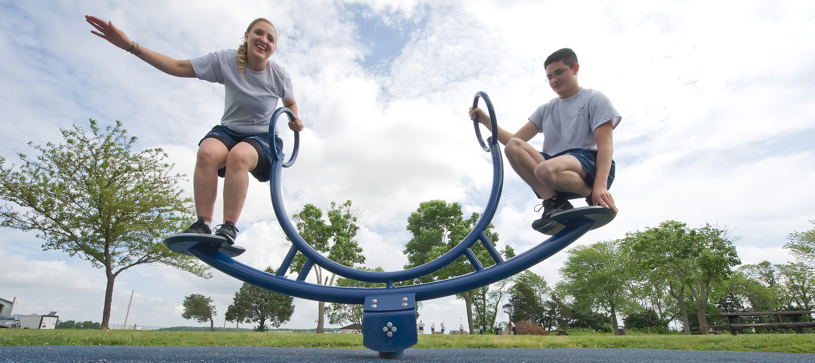
SIMPLE MACHINES AND LEVERS
We will describe levers using forces

Slide 2

State whether it is an attraction force or repulsion force?
A
B

Slide 3
Repeat the opposite word/phrase.
CONTACT FORCES
PHYSICAL CONTACT

Slide 4
Repeat the opposite word/phrase.
NON-CONTACT FORCES
NO PHYSICAL CONTACT

Slide 5
Repeat the opposite word/phrase.
MAGNETIC FORCES
FORCES CAUSED BY MAGNETS

Slide 6
Repeat the opposite word/phrase.
FRICTION
RESISTING FORCE DURING CONTACT

Slide 7
We will describe levers using forces
TRACK WITH ME
READ WITH ME
We will define simple machine
We will describe types of levers
We will describe effort, load and fulcrum
DECLARE THE OBJECTIVE
Read the learning objective to your partner.
Notes:
Learning Objectives contain concepts (nouns, big ideas), skills (verbs, measurable behaviours) and sometimes context (restricting or targeting conditions).
●Example: Students will be able to describe the concept of density and apply it to floating and sinking.
●
Success criteria are specific measurable outcomes that if met mean that the student has met the learning objective.
Examples:
•Students will be able to compare densities of substances using mass and volume.
•Students will be able to identify whether a solid or liquid will float or sink in a liquid based on their densities.

Slide 8
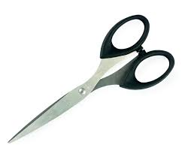
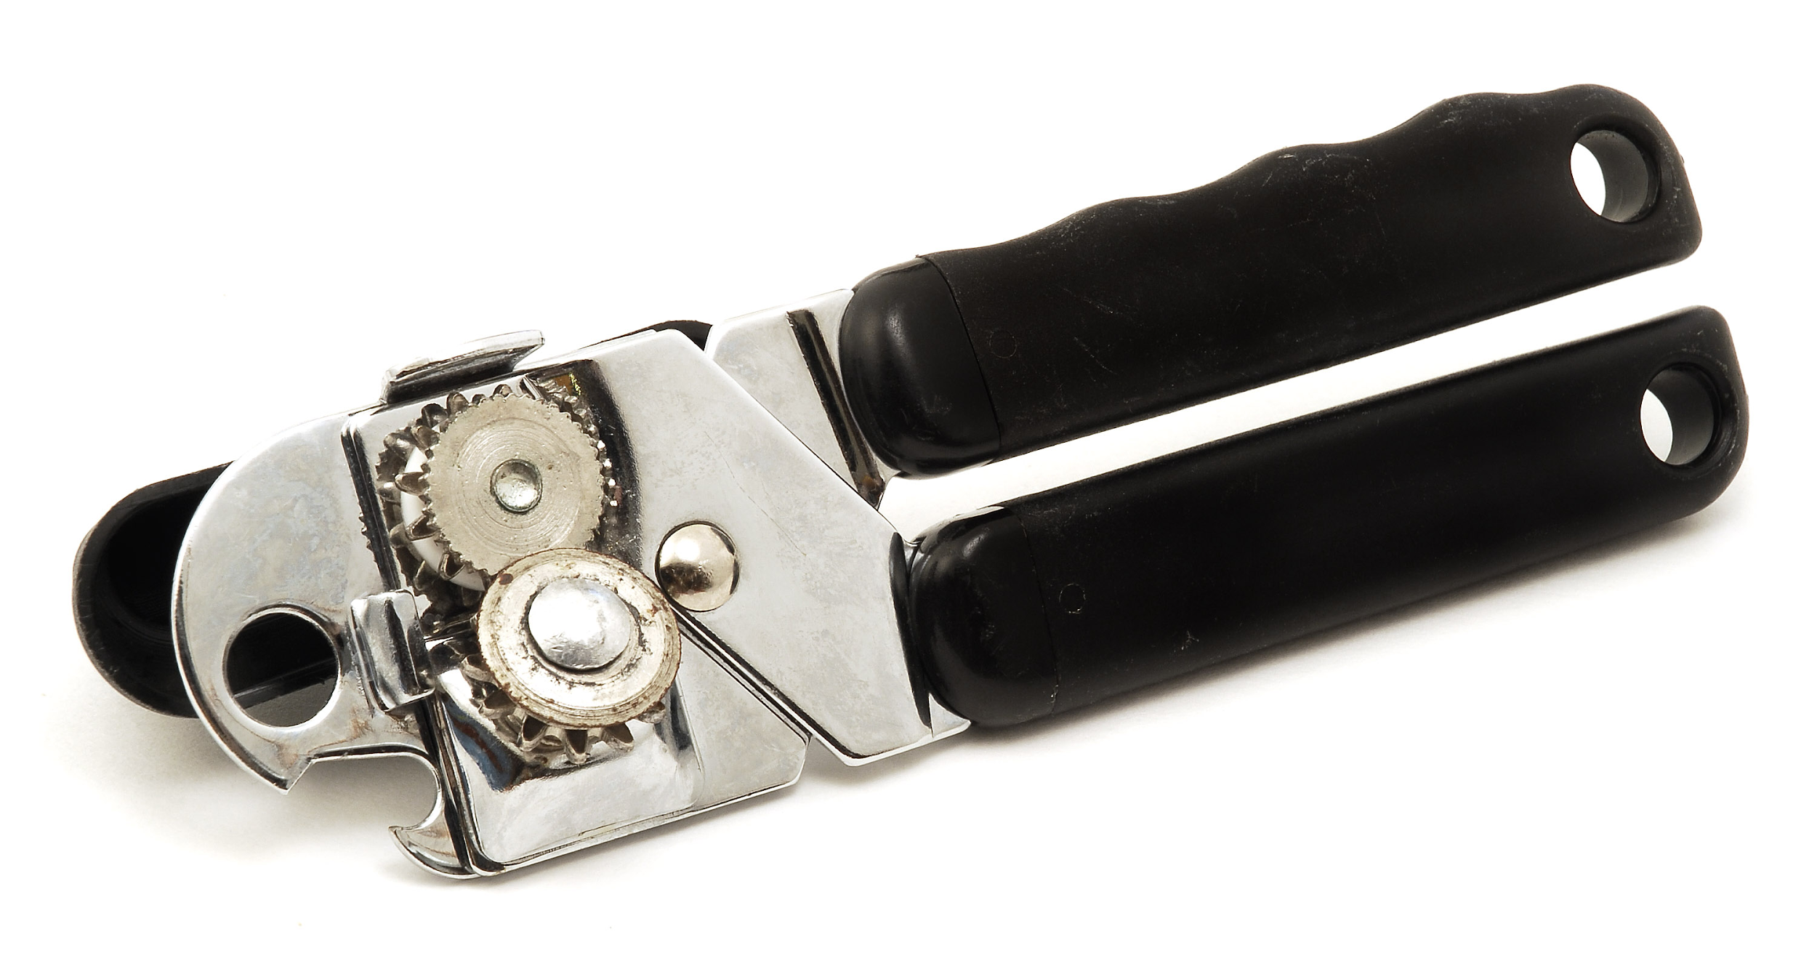
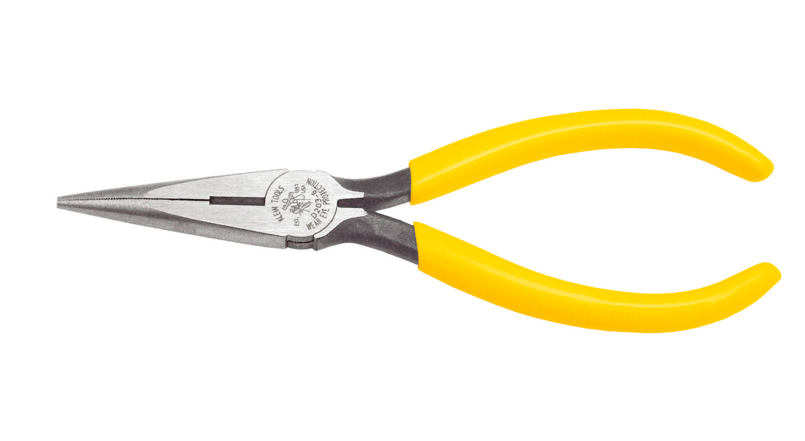
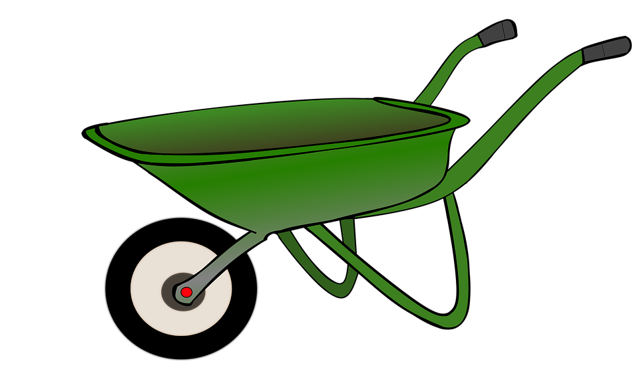
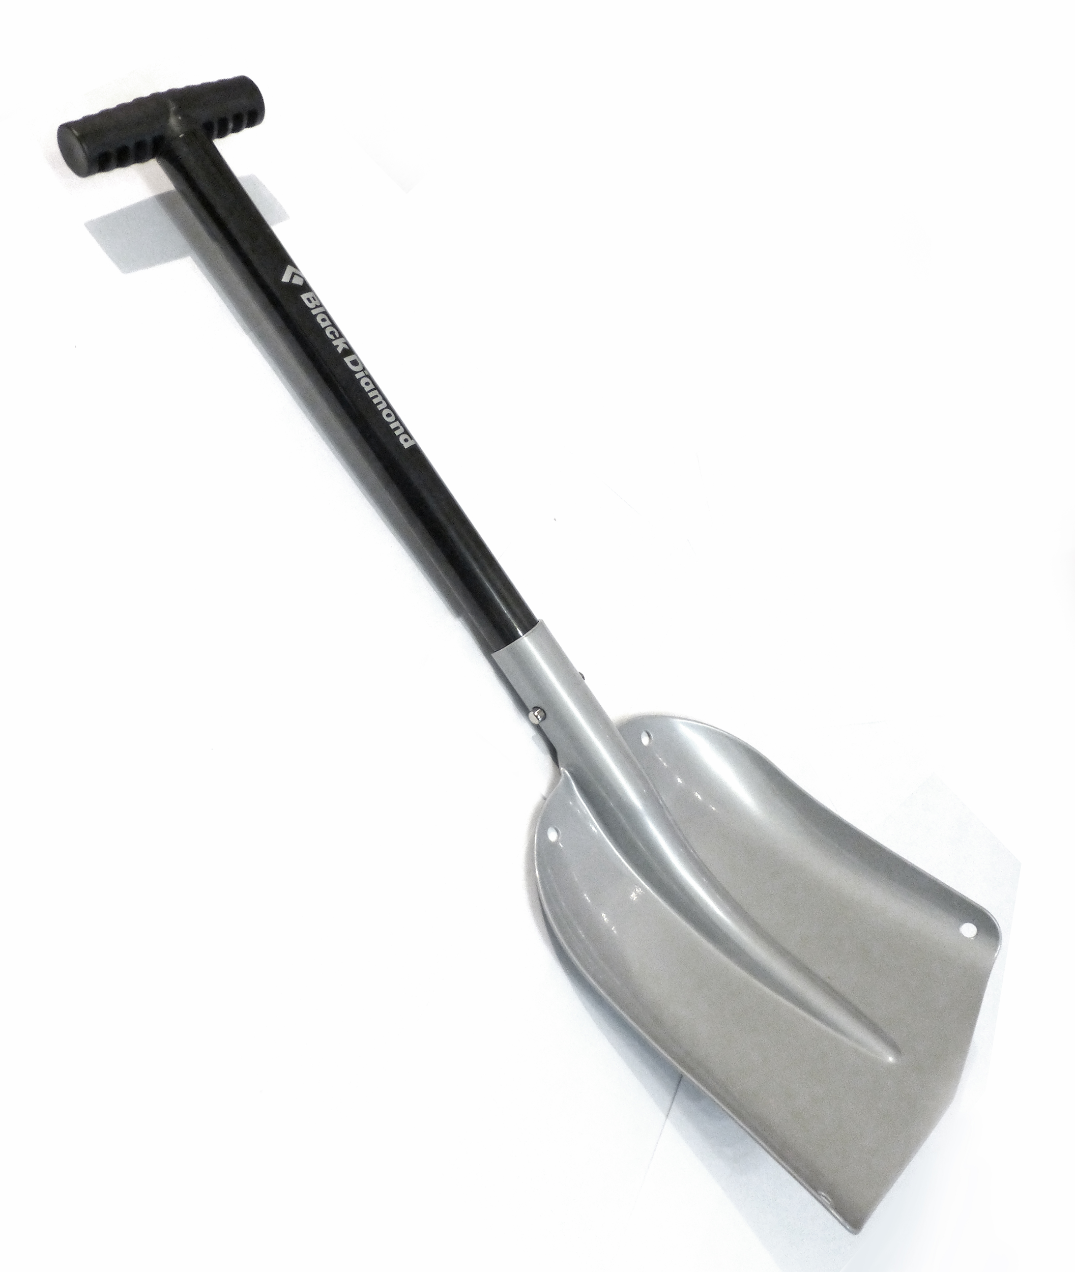
We will describe levers using forces
With a partner choose 3 of these everyday items and describe how you or someone you know uses them. Be ready to share with the class.
Pliers
Can opener
MAKE THE CONNECTION
Students, you already know that everyday items are used to complete various tasks. They are examples of simple machines.
Scissors
Shovel
Wheelbarrow

Slide 9
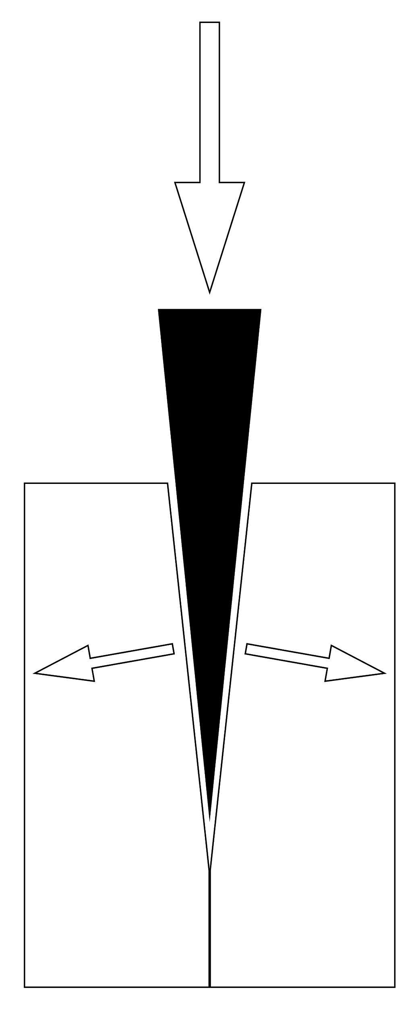
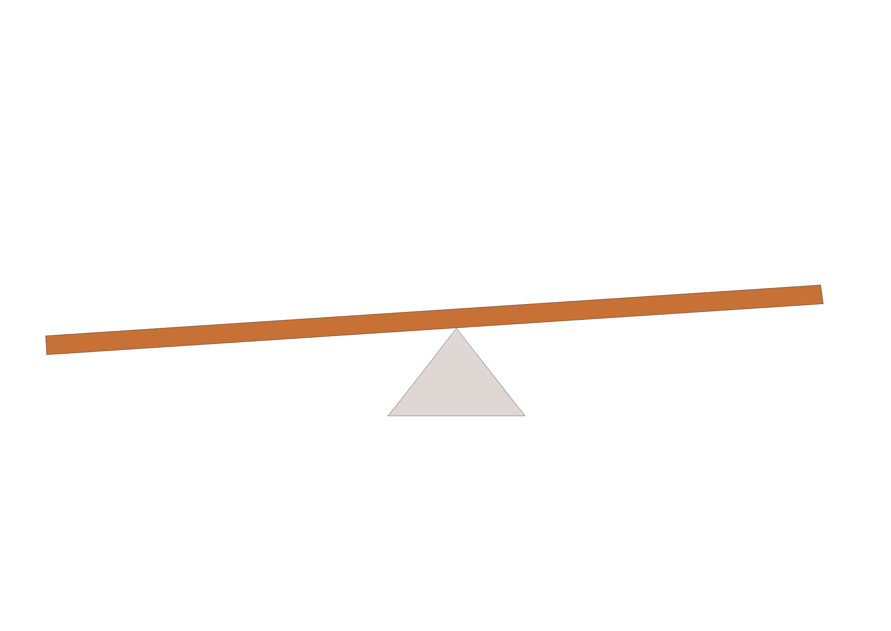
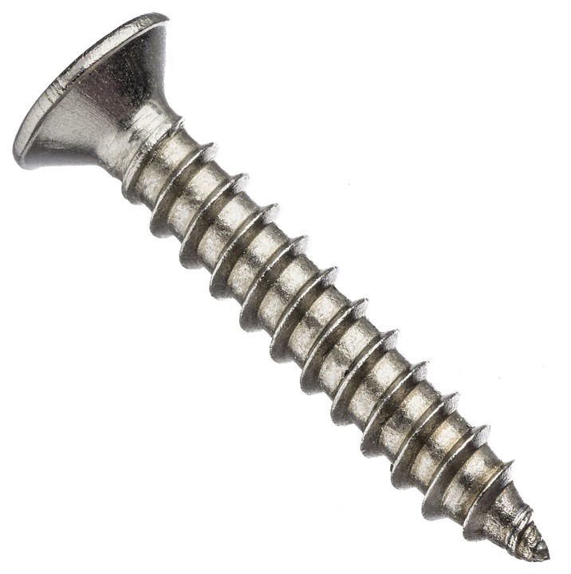
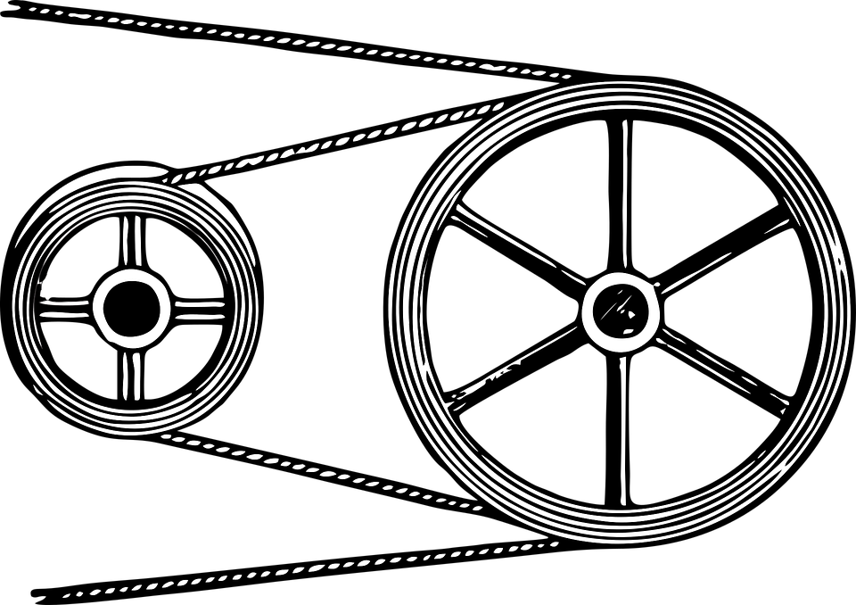
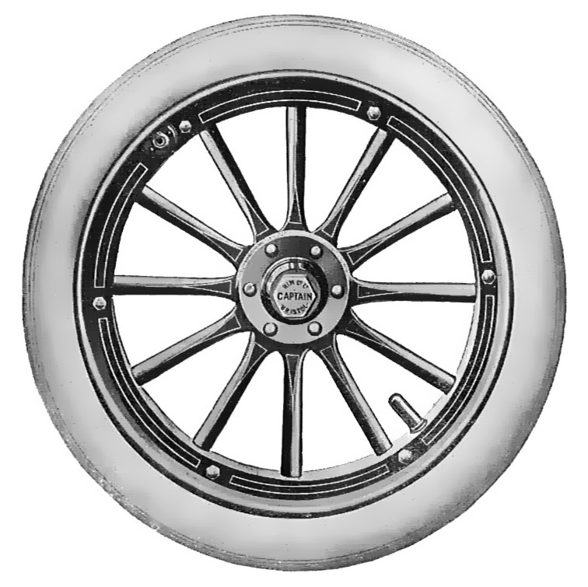
Wedges
Wheels
We will describe levers using forces
Simple machines are devices which make a job easier to do.
The job becomes easier by changing the size, direction or speed of a force.
Levers Pulleys Screws

Slide 10
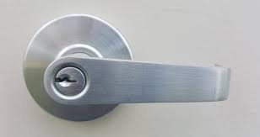
We will describe levers using forces
A lever is a rod₁ that is supported at a turning point called a fulcrum.
An example of a lever is a door handle.
Levers can be used to decrease the amount of effort needed to complete a task. They are an example of a simple machine.
CHECK FOR UNDERSTANDING
In the diagram above which part is the lever, A or B ? Explain your answer.
A
B
lever
fulcrum
DEFINITION
1 - a straight bar usually made from metal or wood

Slide 11
We will describe levers using force
The force used to operate a lever is called the effort and the resisting force is called the load.
Example:
effort
load
lever
fulcrum

Slide 12
We will describe levers using forces
CHECK FOR UNDERSTANDING
Which of the following is an example or a first class lever? A - Using a baseball bat B - Using pliers C - Using tweezers
There are 3 types of levers. First-class, second-class and third-class.
In a first-class lever the fulcrum is between the effort and load. Effort, Fulcrum and Load (EFL).
Using scissors is an example of a first-class lever
effort
load
effort
load
fulcrum
fulcrum
lever

Slide 13
We will describe levers using forces
CHECK FOR UNDERSTANDING
Which of the following is an example of a second class lever? A - Using scissors B - Using a bottle opener C - Using a nutcracker
In a second-class lever the load is between the effort and the fulcrum. Effort, Load and Fulcrum (ELF).
Using a wheelbarrow is an example of a second class lever
effort
load
load
effort
fulcrum
fulcrum
lever

Slide 14
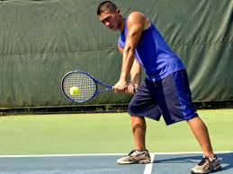
We will describe levers using forces
CHECK FOR UNDERSTANDING
Which of the following is an example or a third class lever? A - Using scissors B - Using a cricket bat C - Using a nutcracker
In a third-class lever the effort is between the load and the fulcrum. Load, Effort and Fulcrum (LEF).
Third-class levers are also distance multipliers. The effort applied will increase the force on the load and the distance it travels. When playing tennis, the tennis racket acts as a distance multiplier.
fulcrum
load
effort
load
fulcrum
lever
effort

Slide 15
We will describe levers using forces
Copy and complete the table below
Everyday item | Lever Class (first, second, third) | Draw a diagram showing effort, fulcrum and load
Nutcracker
Wheelbarrow
Shovel
Scissors
Tweezers
Scissors

Slide 16
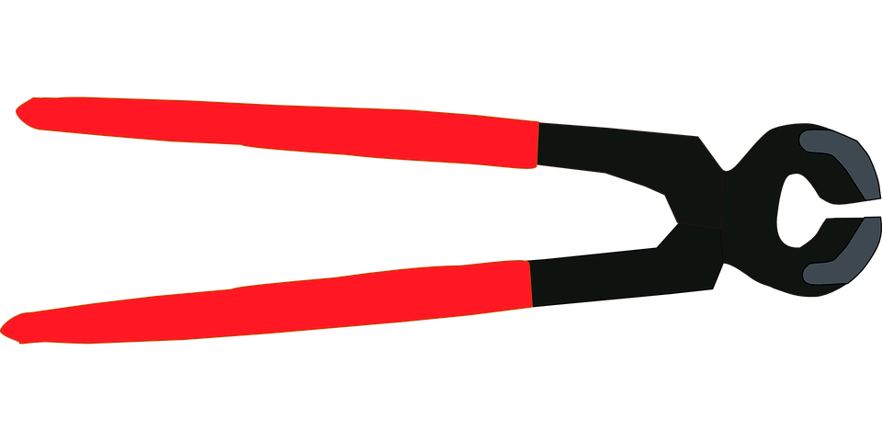
We will describe levers using forces
Today we use simple machines in everyday life to decrease the amount of effort required to do work. Learning how simple machines and levers work allows us to further understand the machines around us. Simple machines make harder jobs easier by using less effort.

Slide 17
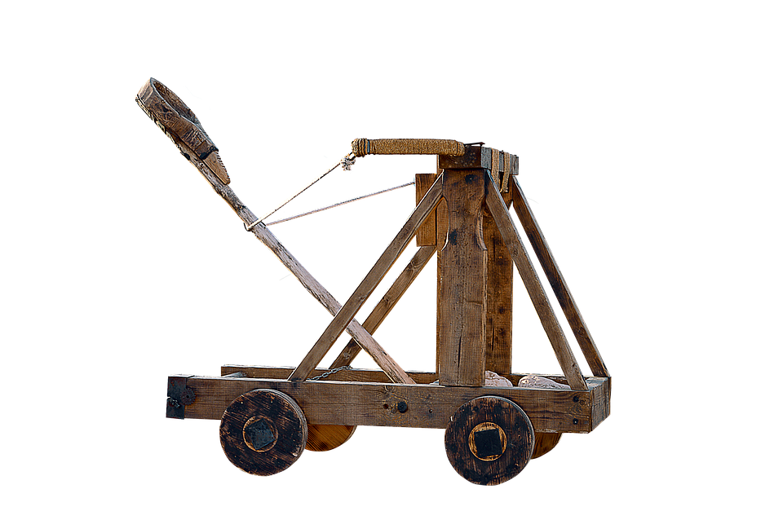
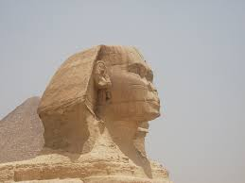
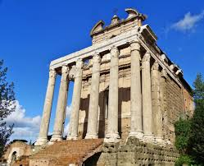
We will describe levers using forces
Ancient Egyptians, Romans and Greeks used simple machines to build pyramids, fight in wars and build cities.
Today we use simple machines in everyday life to decrease the amount of effort required to do work.

Slide 18
We will describe levers using forces
A lever is a simple machine, making jobs easier to do.
A lever is a rod that is supported at a turning point called a fulcrum.
In a first-class lever the fulcrum is between the effort and load. Effort, Fulcrum and Load (EFL).
In a second-class lever the load is between the effort and the fulcrum. Effort, Load and Fulcrum (ELF).
In a third-class lever the effort is between the load and the fulcrum. Load, Effort and Fulcrum (LEF).

Slide 19
We will describe levers using forces
What are the 3 different types of levers?
Which of these statements are true or false?
A lever is a simple machine that can increase the effort supplied to get a job done
If using a crowbar to lift a tree stump, then the tree stump is called the effort
A crowbar used as a lever rotates about a point called the fulcrum
When using the claw of a hammer to pull a nail out of a piece of wood, the hammer acts as a force multiplier
Notes:
Please include tasks/questions here rather than just referring to a worksheet. This will save on photocopying and facilitate sharing with other schools.
Try and build tasks/questions which escalate through Bloom’s Taxonomy. This will help with differentiation.

Slide 20
We will describe levers using forces
3. Tim uses the handle of a spoon to lift the lid from a can of Milo. Identify what acts as the: a) effort b) load c) fulcrum
4. Identify the following as first, second or third-class levers.
Load positioned between the fulcrum and the effort
Fulcrum positioned between the effort and the load
Effort positioned between the fulcrum and the load
REMEMBER THE CONCEPT
First- class lever Effort, Fulcrum and Load (EFL). Second-class lever Effort, Load and Fulcrum (ELF) Third class lever Load, Effort and Fulcrum (LEF)

Slide 21
We will describe levers using forces
We will define simple machine
We will describe types of levers
We will describe effort, load and fulcrum
CHECK FOR UNDERSTANDING
Check Success Criteria.
Notes:
Learning Objectives contain concepts (nouns, big ideas), skills (verbs, measurable behaviours) and sometimes context (restricting or targeting conditions).
●Example: Students will be able to describe the concept of density and apply it to floating and sinking.
●
Success criteria are specific measurable outcomes that if met mean that the student has met the learning objective.
Examples:
•Students will be able to compare densities of substances using mass and volume.
•Students will be able to identify whether a solid or liquid will float or sink in a liquid based on their densities.

Slide 22
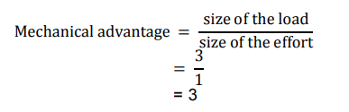
We will describe levers using forces
Levers gives us mechanical advantage. The size of the advantage can be calculated by dividing the size of the load by the size of the effort:
Example: A wheelbarrow has a 3 N load and needs 1 N effort to lift it.
What is the mechanical advantage of the wheelbarrow?

Slide 23
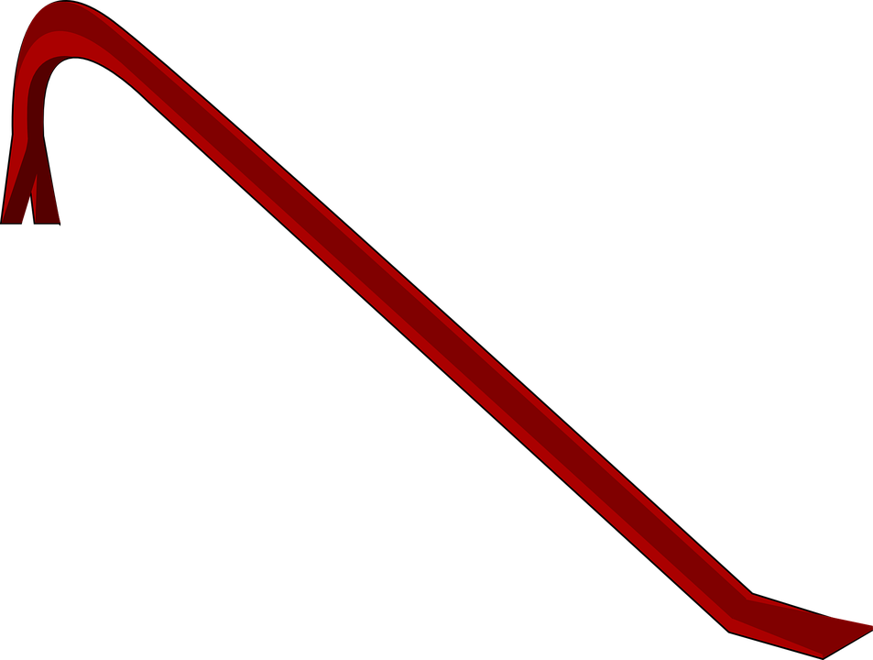
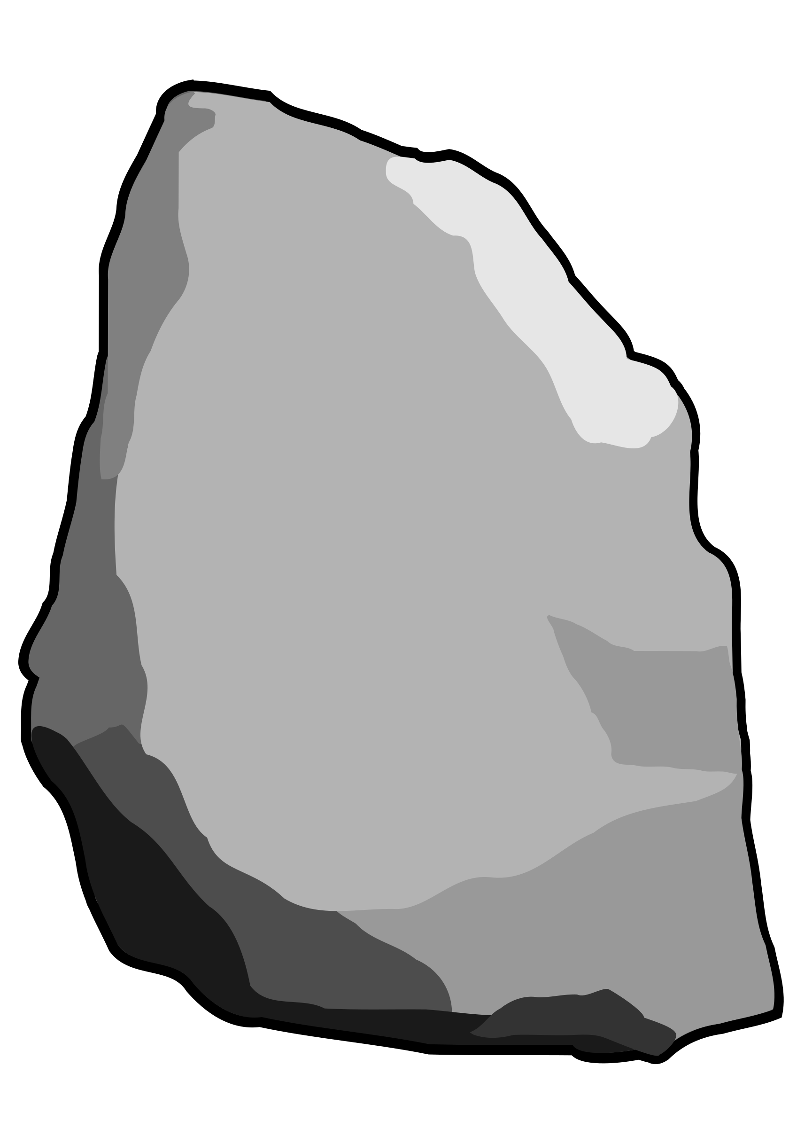
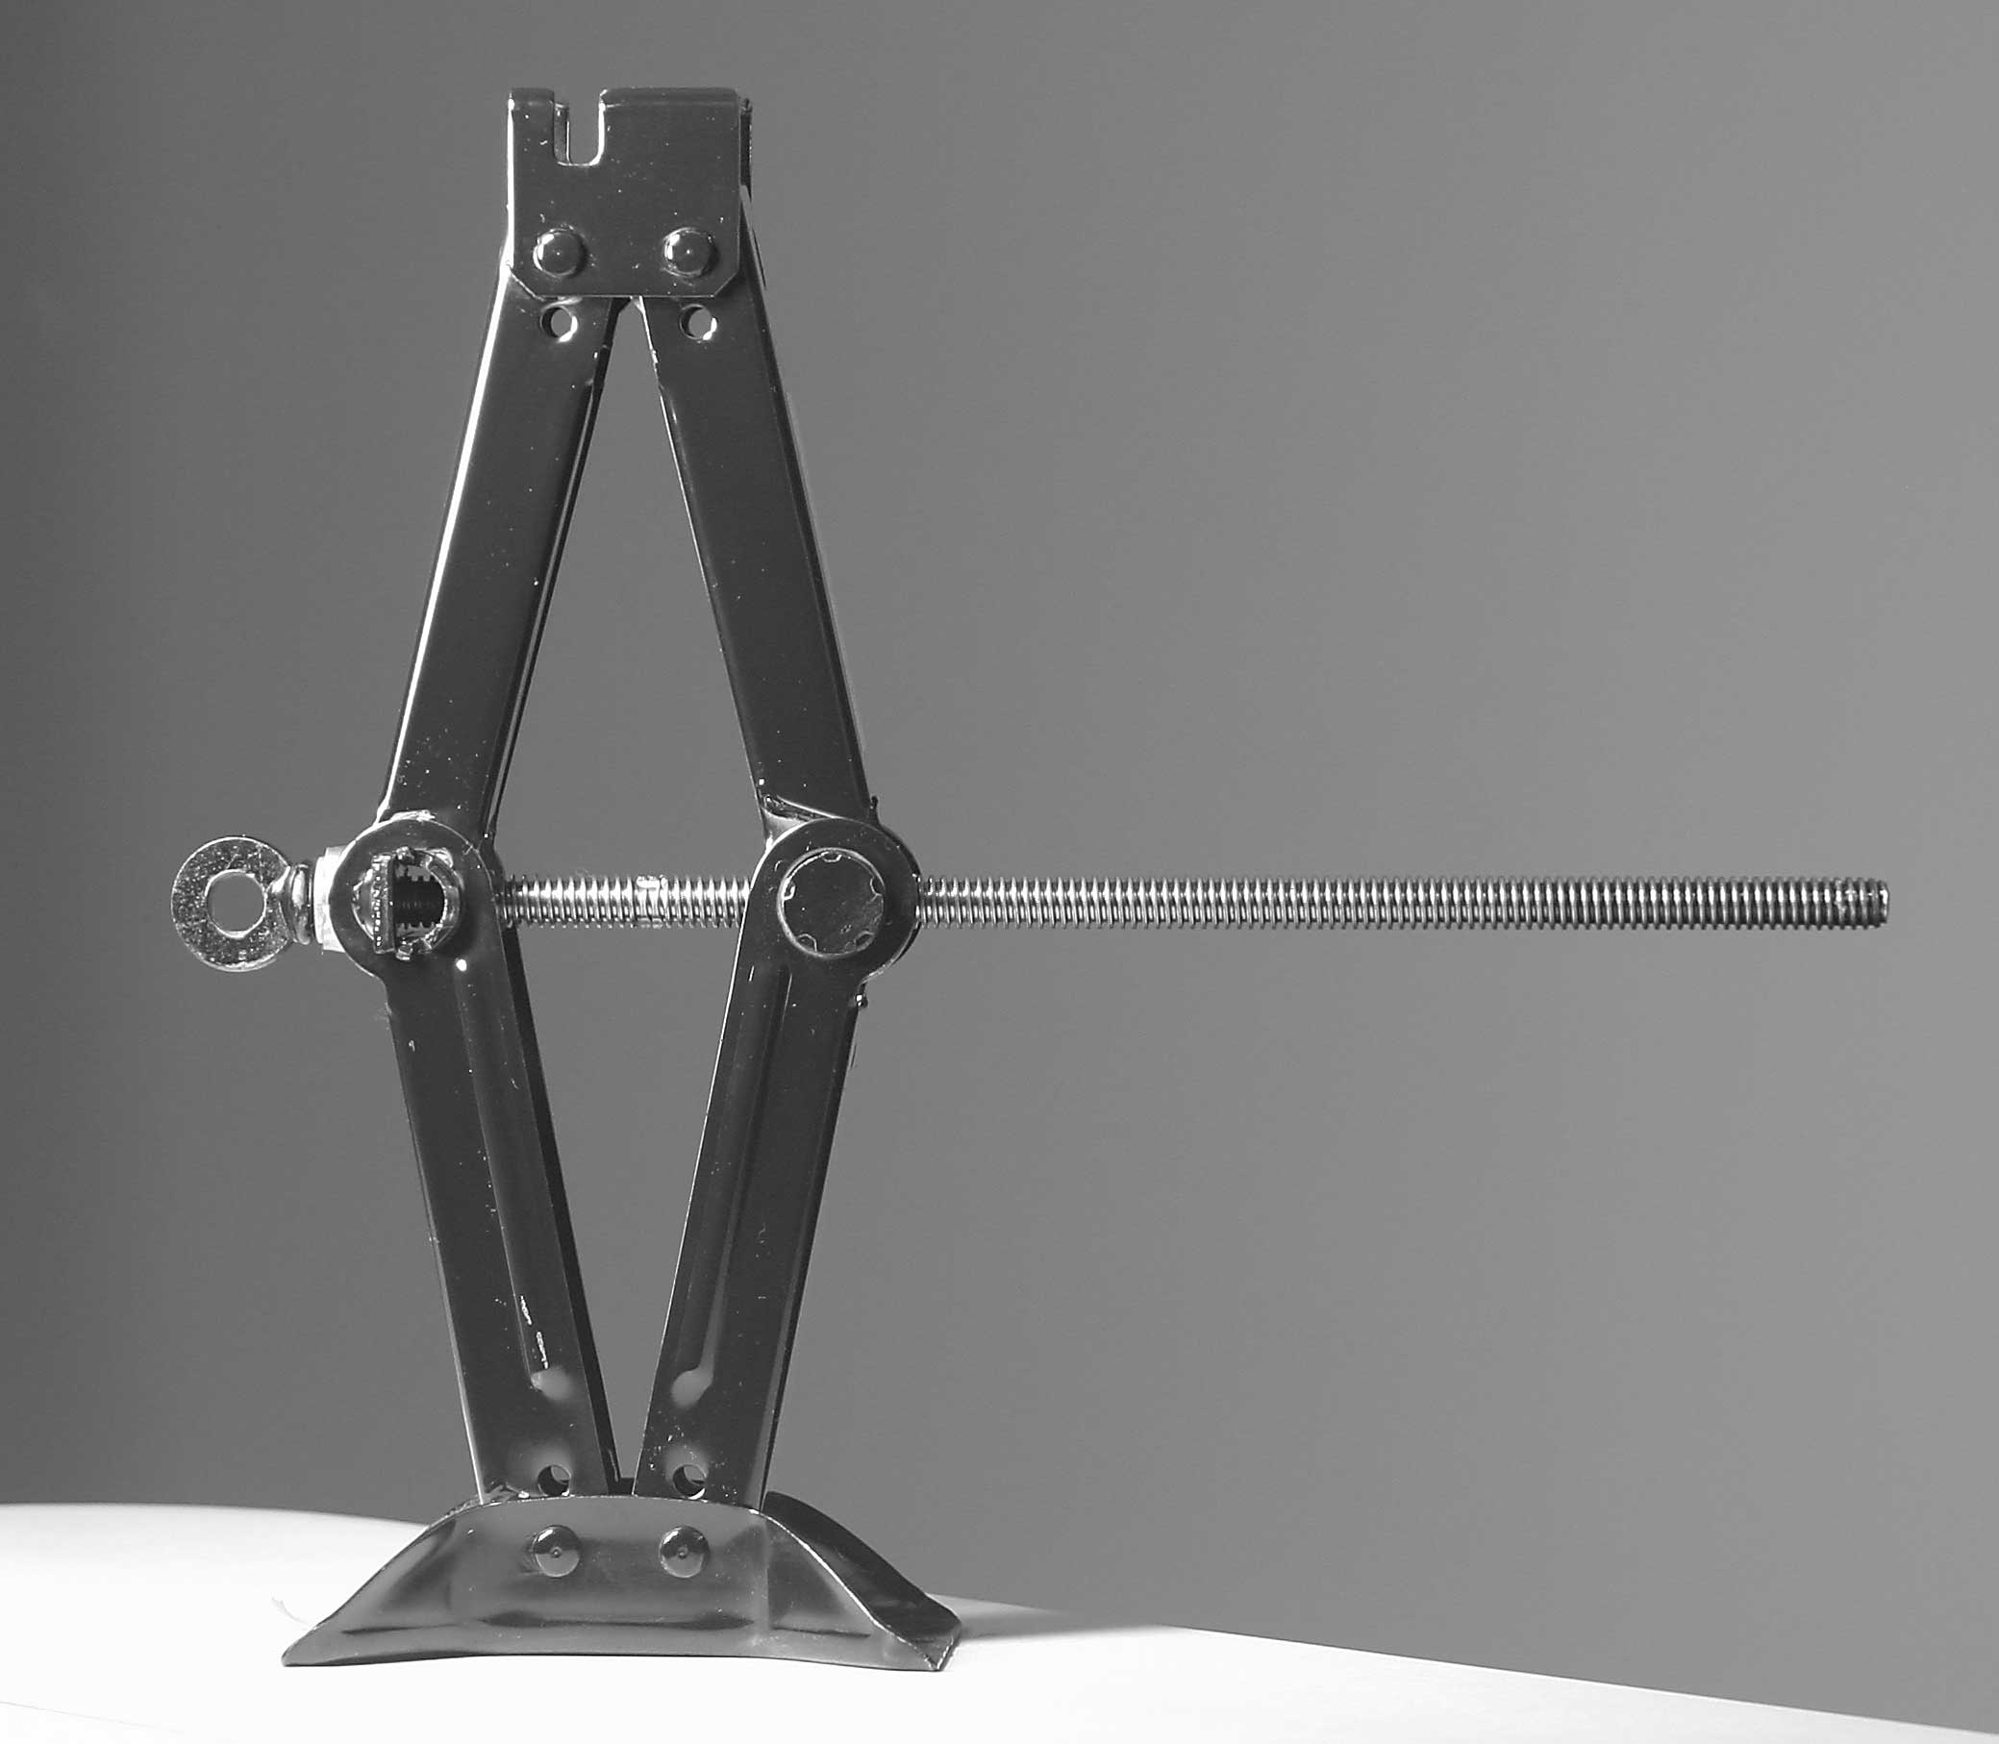
We will describe levers using forces
CHECK FOR UNDERSTANDING
Using a full sentence what does a force multiplier do?
Some levers are called force multipliers. They can change a weak force into a strong force.
Examples:
Using a crowbar can give a person leverage to lift a heavy object.
Using a jack to lift a car.

